Slide 1
Ks2 Music quiz 🎶
Made by music leaders.

Slide 2
On your whiteboard or on some scrap piece of paper write your answers and when you finish, swap your answers with your partner and see how much you get correct! If you don't know, just have a guess.
You have a minute on each of the questions!

Slide 3
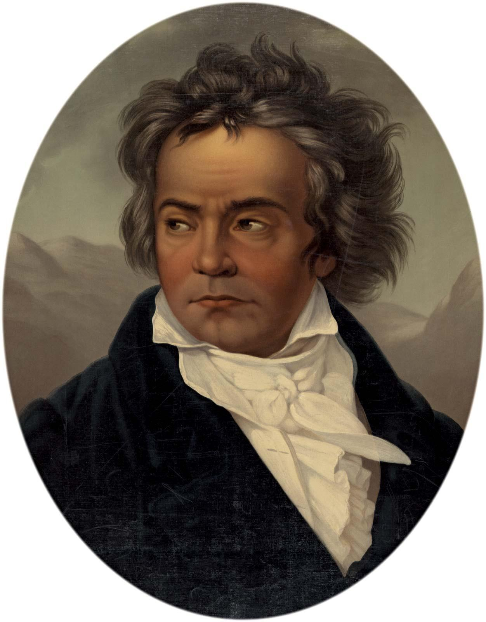
Who was the most famous romantic composer?

Slide 4
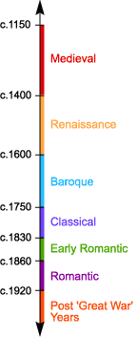
2. Which era was mozart in?

Slide 5
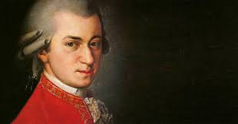
3. When was mozart born?

Slide 6
4. When did mozart die?

Slide 7
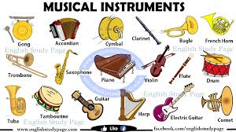
5. What was the first instrument ever made?

Slide 8
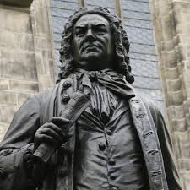
6. How old was Bach when he died?

Slide 9
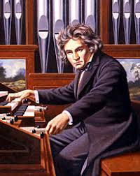
7. What was Beethoven’s first song?

Slide 10
Answers

Slide 11
Beethoven

Slide 12
2.classical

Slide 13
3. 27 Jan 1756

Slide 14
4. 5 December 1791

Slide 15
Flutes \ Neanderthal flute
The flutes were made in the Upper Paleolithic age, and are more commonly accepted as being the oldest known musical instruments. Archaeological evidence of musical instruments was discovered in excavations at the Royal Cemetery in the Sumerian city of Ur.

Slide 16
6. 65 yrs
He died of complications after eye surgery in 1750 at the age of 65. Bach enriched established German styles through his mastery of counterpoint, harmonic and motivic organisation, and his adaptation of rhythms, forms, and textures from abroad, particularly from Italy and France.

Slide 17
7. 9 variations in c minor
Did you know that beethoven was only 12 when he wrote this song!!!

Slide 18
Thank you

