Slide 1


Exploring identity online

Slide 2
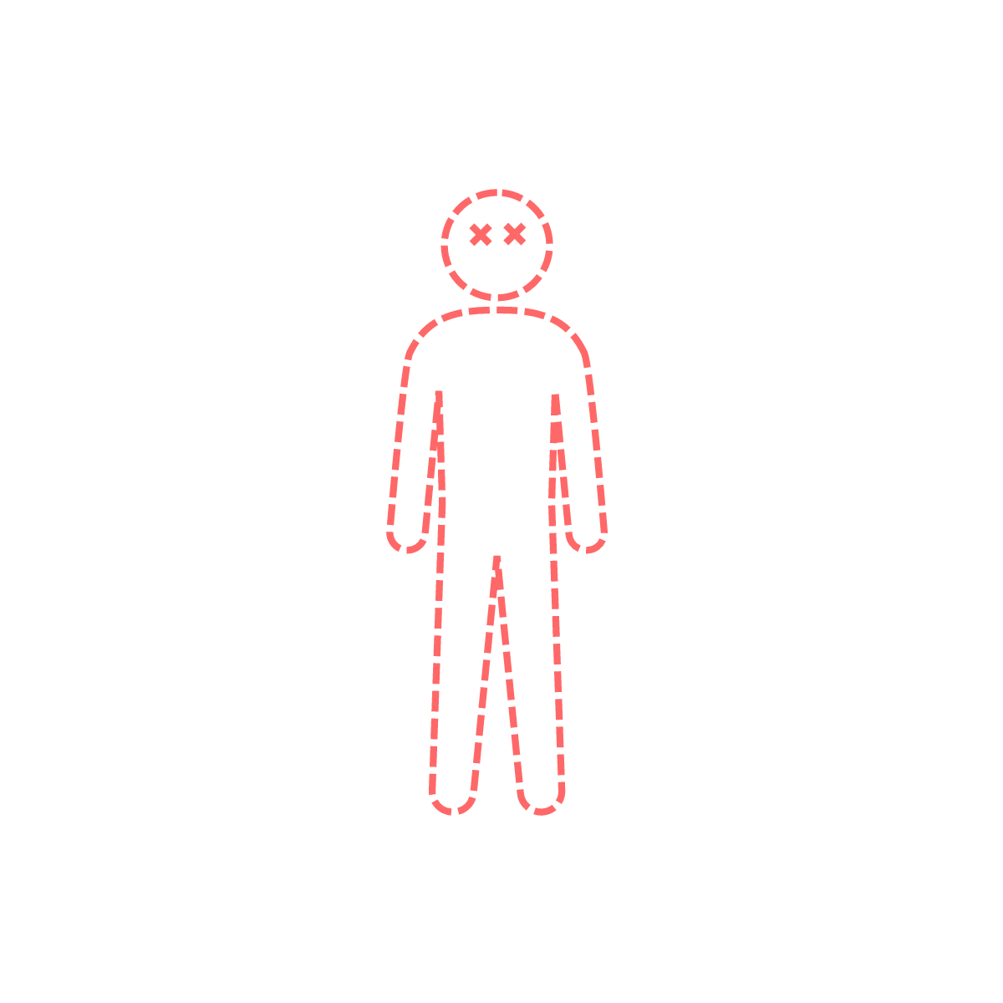















What is your identity?
What makes you…
YOU?

Slide 3
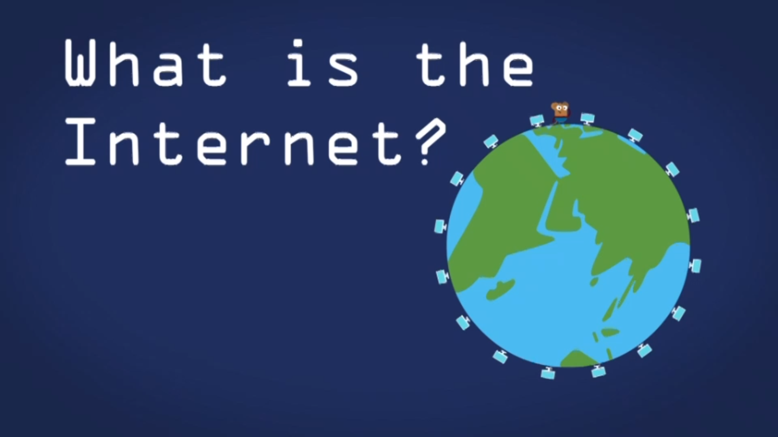
What is the internet?
Notes:
Click picture to link out to BBC Bitesize video - https://www.bbc.co.uk/bitesize/articles/zgwnsbk

Slide 4
















What uses the internet?

Slide 5

This is me!
A poem about online identity

Slide 6


The internet’s a super place,
To play, to learn, to chat.
A space for us to be ourselves,
So let’s remember that.

Slide 7

Your cousins live across the world,
A thousand miles away.
But thanks to WiFi, face to face,
You see them every day!

Slide 8


You crave adventure, games and fun,
You play on many teams.
You build your castles and your lands,
And live your wildest dreams.

Slide 9

It’s great to share your favourite things,
With friends across the nation.
But keep offline, and just for you,
Your personal information.

Slide 10

If you’re online and feeling sad,
Worried, or upset,
Tell a grown-up straight away…
It’s the best help you can get!

Slide 11



The safety tools are always there,
To keep things running well.
Block, report or flag it up,
It’s important that you tell.

Slide 12

No two people are alike,
Even if you’re twins.
Be yourself and keep in mind,
That kindness always wins.

Slide 13

There’s just one you and you are FAB,
I think that you’ll agree.
Express yourself and be proud to say…

Slide 14

