Slide 1
Music through history
By Noel, one of your Music Captains :)

Slide 2
Hello there friends. I have a mission for you. I need you to help me learn more about music history. I know you are up for the challenge. We will go from eras to instruments and finaly modern-day music. Lets go!

Slide 3
Eras

Slide 4
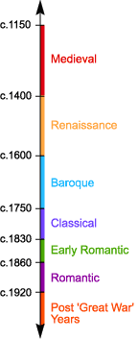
Eras
There are many different types of eras and i am pretty sure that you can tell the diffrence just by listening. Medieval music is the oldest type of era in music. By listening to it you can say it is kind of medieval, that’s probably how it got its name.
Renaissance isnt very different. Has about the same amount of instruments as it would in the Medieval and sounds the same. This was around the time of king Henry VIII.
Here is some of the music.
Medieval Music
Renaissance Music

Slide 5
Eras
Baroque is an era when some of the instruments that we have today were made. For example: the piano. In this time, people got smarter and started making more instruments but that is for later.
Now for classical music. No not the channel you listen to on the radio, well not if you are 221 years old! Also, clarinets were invented in this era. As you may already know, famous composers like Beethoven and Mozart were in this era.
Let's listen to something during these eras.
Baroque music
Classical music

Slide 6
Eras
There was lots of exciting things in the romantic Era, Like the flute, oboe, saxophone and tuba. These are the instruments that helped music sound as good as it is know! The romantic period was a time of war, with the French Revolution, followed by the Napoleonic wars until 1815.
In the 20th century, music changed alot. Bit by bit, its starting to be like music we hear today. Lots of new instruments were made then and still use today. The 20th century isn't very far far from now. Only 22 years ago was the last year of the 20th century.
Here is some music.
Romantic music
Early 20th Century music

Slide 7
Hello again friends, we made it past the eras. I've learnt so much all ready! Thank you. It is now time for...

Slide 8
Instruments

Slide 9
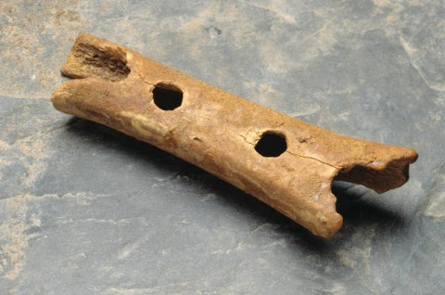
Flute
The flute. The flute is one of the oldest instruments ever made. That is why the flute in the picture looks weird. it was made in 1830 which still wasn’t long ago. It has been played all through out history and some of you may play it too! It is a fascinating instrument and has a lovely sound. I think you would like it too!

Slide 10
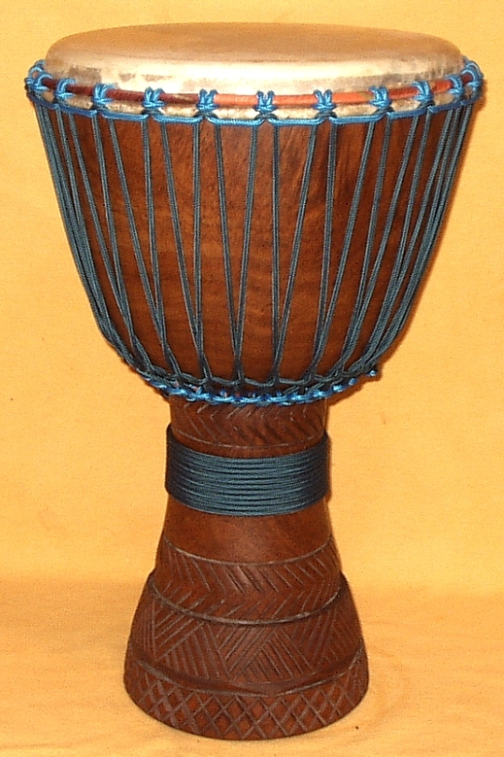
Drums
The drums are another type of old instrument. This time they were made in 6000 BC and I can tell you, that is a very very long time ago. Even though it is this old, people still use it today! This is true but people have got more creative and have made more types of drums like the drum kit and the djembe drum like the one it the picture I found.

Slide 11
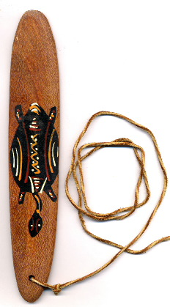
the bull-roarer
You may not have heard of the bullroarer. It looks quite weird. Bullroarers are used by holding the string in one hand and whirling the piece of wood. As it moves through the air, it creates a low pitched sound capable of traveling long distances. The bullroarer, rhombus, or turndun, is an ancient ritual musical instrument and a device historically used for communicating over great distances. It dates to the Paleolithic period, being found in Ukraine dating from 18,000 BC.

Slide 12
Yes! We’re almost done! You guys are brilliant! Two down, one to go and that one is...

Slide 13
Music today

Slide 14
POP
This is a type of todays music. Pop music stands for popular music and I think it is. People listen to it no matter who they are or where they are. Some people like it more than others, some don’t like it at all but that’s completely fine! Pop is a genre of popular music that originated in its modern form during the mid-1950s in the United States and the United Kingdom. The terms popular music and pop music are often used interchangeably, although the former describes all music that is popular and includes many different styles.

Slide 15
Rock
Rock music is harder and harsher than other types of music genres. It uses instruments like guitar, bass guitar and drums but can use more than this. Some may think that rock is just a bunch of crazy people who flick their hair up and down stiking their tounge out and in some cases that can be true but not always. Sometimes rock can be soft no matter how weird that may sound.

Slide 16
Disco
Disco is another type of music we listen to today. It sounds a little electric if you know what I mean. People may call it dance music because if you went to a party or a school dance, this would be the type of music that would be there.

Slide 17
Wow! I do not know what to say! I have learned do much from you! Thank you for following me through my adventure through “ music history.” Now I know that I can go on many more adventures with you.
See you later!

Slide 18
Thank you :)

