Slide 1

Welcome to our
Meet the Teacher presentation
Teacher: Mr Froud
Support staff: Mrs Cooney and Mrs Wilson-Boyle
Phase Leader: Mrs Bastian

Slide 2

Routines and Expectations

Slide 3
Vision
We want our school to be outstanding in all areas of learning, pastoral care and faith formation. We aim to nurture a love of learning, with Jesus at the heart of all we do.
Mission Statement
Guided by truth, respect and compassion; we share in building upon every individual’s foundation, nurturing a love of learning in preparation for tomorrow’s society, with Jesus at the heart of all we do.
Values
Faith Hope Love
School Development Plan
SDP 1 | SDP 2 | SDP 3
Excellence in teaching, learning and curriculum | Excellence in wellbeing and personal development | Excellence in Leadership
Key Focus: To ensure all children know more, remember more and do more through effective use of Adaptive Teaching | Key Focus: To maintain/develop a strong sense of belonging for all children, families, staff and governors (irrespective of faith/worldviews held),using the Catholic Social Teaching Principles. | Key Focus: Develop leaders and leadership structures to effectively support the professional development of staff.

Slide 4
Behaviour for Learning
At Sacred Heart we follow 4 simple rules:
We are safe
We make good choices
We are kind
We do our best
We are safe
Everyone at Sacred Heart is valued and respected as an individual within a safe, positive learning environment.
We make good choices
Children are given the opportunity to reflect on their options and learn how to make the right choices in all situations.
We are kind
All at Sacred Heart are special and important and we celebrate this ethos through sharing our kindness and love for each other.
We do our best
Everyone is encouraged to take pride in our school, their class, their work and their relationships.

Slide 5

Routines
Drop off – pedestrian gate opens at 8.25am and closes at 8.50am Please wait in the playground with your children
 | Nursery Gate | Reception Gate | Y1/2 garden | Y3/5 door by Nursery | Y4/6 door by the steps
8.30am | AM Nursery
8.35am |  | Reception | Year 1 Year 2 | Year 3 Year 5 | Year 4 Year 6
12.30pm | PM Nursery
Pick up- pedestrian gate opens at 3.10pm
 | Nursery Gate | Reception Gate | Y1/2 garden | Y3/5 door by Nursery | Y4/6 door by the steps
11.30am | AM Nursery
3.15pm |  | Reception | Year 1 Year 2
3.20pm |  |  |  | Year 3 Year 5 | Year 4 Year 6
3.30pm | PM Nursery
Children who have not been picked up by 3.30pm will wait in the medical room. Please collect them from the office. If children are not collected by 3.40pm they are placed in ‘Kids Klub’ and charged accordingly.
Safeguarding:
Pick up and drop off can be busy and there are often little children around. To reduce the chance of injuries, we ask children not to ride bikes or scooters or play ball games.
Children will only be dismissed to their parents or those adults who normally collect them.
Parents must notify the school office if someone else is picking their child up. Teachers cannot speak to parents over the phone in the playground.
Only Year 6 pupils may walk home on their own - please provide written permission. Year 6 pupils cannot take younger siblings home.

Slide 6
Communication
For queries about dates, the calendar, clubs or pick up, please communicate with the office directly
by calling or emailing.
For questions, queries or concerns around your child’s learning or wellbeing, your child’s class teacher should be contacted. If you feel that something is not resolved, please contact your child’s phase leader who will also be able to support.
Who to contact? (In order)
Class teacher (Mr Froud)
Phase Leader (Mrs Bastian)
Inclusion Lead (SEND, Pupil Premium, English as an additional language) (Mrs James)
Assistant Headteacher (Mr Connell & Mrs Bastian)
Deputy Headteacher (Mrs Heffron)
Headteacher (Mrs Norville)
Email
Staff email addresses can be found on our school website. Staff should respond within 24 hours. If it is urgent, please call or email the school office: school@sacredheart.merton.sch.uk
Please note that staff are not required to respond to emails out of school hours or in the holidays.

Slide 7
Communication and Calendar
Website
Our website has both the term dates and a calendar indicating school events such as assemblies, Masses or PSA events. Dates are subject to change so please check the calendar regularly. If anything is missing, please email Mrs Bastian (tbastian@sacredheart.merton.sch.uk).
Newsletter
Our newsletter is emailed weekly and uploaded to the website. The website shares news, photos and updates about life at Sacred Heart. These also share upcoming dates or events.
Social Media (Instagram, Facebook and ‘X’ Twitter)
We regularly share news, photos and updates on our Facebook and Twitter page also.
Contact information
Please ensure that all your contact information is correct – please see the office if you need to make any changes.
Photo Permission
Please ensure that you have given photo permission to the office!

Slide 8
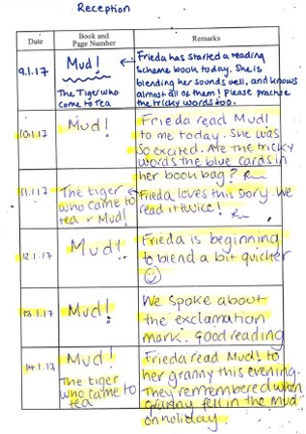
Communication and Calendar
Reading Diaries
Each child has a reading diary – these should be used for the following:
To indicate when a child has read at home (daily)
To indicate when a child has read with an adult in school
To write any notes or questions to the adults – if urgent or sensitive, please send a separate note or email.
Google Classroom
Often reminders for pupils and parents such as non-uniform Days, trips, assemblies etc. are added to the Google Classroom stream.
Emails and text messages
Some letters or messages are emailed home. If we need to contact parents urgently regarding changes, we will send a text message.

Slide 9
Communication between parents
WhatsApp groups set up by parents/parent reps are designed to help and support all families.
They are not run by school or an official school channel of communication but we recognise that they are a useful tool for class representatives and parents. Please see the reminders below about social media and our school.
Out of respect for other children and their families, parents/carers must not discuss individual children on What's App/social media groups.
Parents/Carers are advised to contact school should they have any concerns regarding their child. The platform should not discuss other children or incidents that are being managed within school.
Ensure that any misinformation (or information that is inappropriate) being shared by members of the school community does not cause unnecessary distress to children as well as parents/carers and staff.
Any comments shared on social media be kept factual and supportive, with links to the official school information where possible.
Parents/Carers with concerns that these rules (designed to support all families) are not being followed should take 'screenshots' and contact school for support.

Slide 10
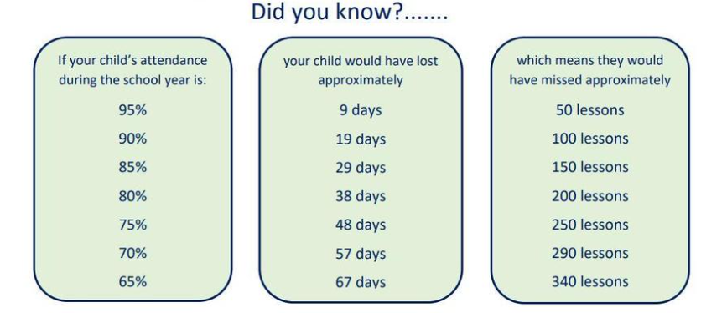
Attendance
Regular and punctual attendance is key to children’s learning, attainment and progress, both academically and socially.
In simple terms, the more absences a child has (including lateness), the more learning they miss. This makes it harder for them to
reach their full potential.
Illness
If a child is to unwell to attend school - that is the right thing to do, however, medical advice is clear that children with mild illness e.g. a cough or cold without a high temperature, will often be well enough to attend.
To report your child absent, please leave a message on the school telephone 020 8942 0215 – option 1, before 9:30am on the first day. Please give your child’s name, class, reason for absence and expected date of return.
Planned absence
Children should not be taken out of school during term time unless there are exceptional circumstances (the DfE does not consider holidays or visiting family overseas to be exceptional). Any planned absence during term must be applied for in writing at least two weeks in advance, forms are available from the office.
Celebrating Attendance
Class certificates are awarded weekly in celebration assembly and the newsletter. Individuals are awarded with termly attendance postcards. Special badges are awarded at the end of each school year to every child who has achieved 100% attendance.
Please do make an appointment with the class teacher and/or
Mrs Marcelline our Attendance Officer if you have concerns regarding your child’s attendance.

Slide 11
Uniform
We have high expectations at Sacred Heart. One way of demonstrating this is the pride that we share as a school community in our uniform.
Our uniform policy updated can be found on our website: https://www.sacredheart.merton.sch.uk/uniform-information/ and on the next page.
Please support us by ensuring that your child arrives smartly in correct uniform. We will be monitoring that all children meet our high expectations.
PE Kit
Pupils in Years 1-6 will arrive at school wearing their PE kit on their PE days (see below).
Our class/year group PE day is:
St Josephine Class: Monday and Wednesday
St Maximillian Class: Monday and Friday
Please ensure all clothing items are clearly labelled with your child’s first and last name.
Lost property can be found in the storage bins beside the Nursery.

Slide 12
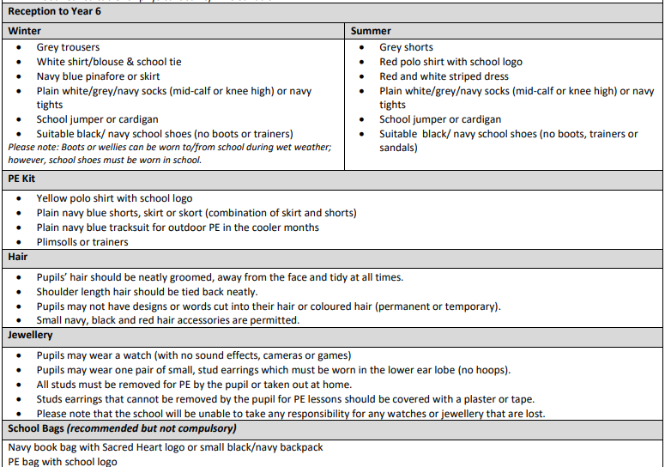
Uniform
Please ensure all clothing items are clearly labelled with your child’s first and last name.
Lost property can be found in the storage bins beside the Nursery.

Slide 13
Teaching, Learning and the Curriculum

Slide 14
Curriculum
Sacred Heart Catholic Primary School – Curriculum Intent We strive to nurture a love of learning through excellence in learning, pastoral care and faith formation.
Faith | Hope | Love
Our curriculum: Engages and enthuses learners Empowers pupils to confidently articulate their beliefs; Sets high expectations for all pupils so that no child is left behind; Encourages pupils to have resilience and faith in themselves | Our curriculum: Allows pupils to be challenge themselves and each other; Encourages pupils to work collaboratively to build on existing skills and knowledge and acquire ones also Is continually developed through effective CPD and reflective dialogue and practice; | Our curriculum: Promotes Gospel and British Values, loving and celebrating differences Promotes self-motivation for a life-long love of learning; Allows opportunities to serve others so pupils develop a sense of citizenship; Aims to develop physical and mental health

Slide 15
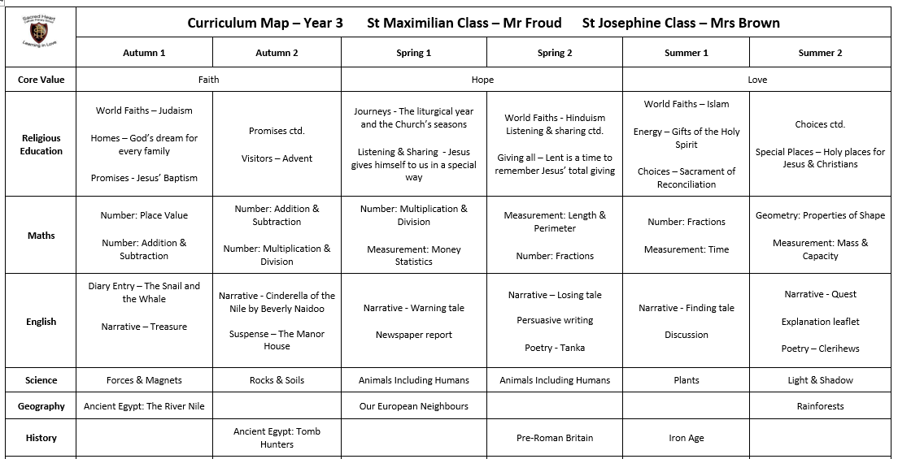
Curriculum
We strive to nurture a love of learning through excellence in learning, pastoral care and faith formation.
.
Each term, we will send out a curriculum newsletter.
This will describe in more detail what your child will be learning about in the upcoming term.

Slide 16
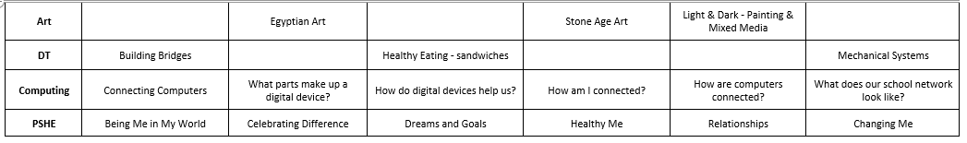
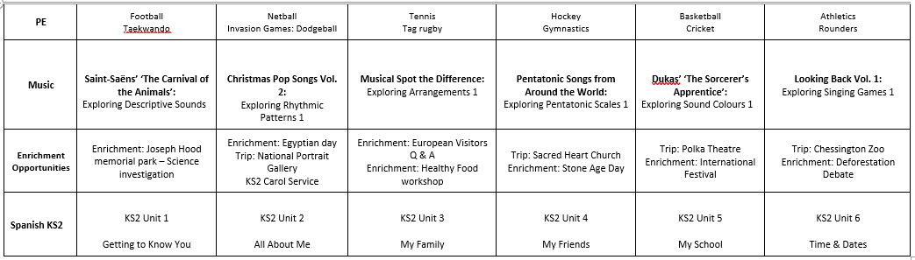
Curriculum
We strive to nurture a love of learning through excellence in learning, pastoral care and faith formation.
.

Slide 17
Curriculum
We strive to nurture a love of learning through excellence in learning, pastoral care and faith formation.
In order to deliver a broad and balanced curriculum, some subjects are taught daily and weekly.
Each term, we alternate between History / Geography and Art / DT.
Daily | Twice a week | Once a week
EYFS/KS1 Phonics | RE | Whole Class Guided Reading
Maths | Science | PSHE
English | PE | History or Geography
Prayer and Liturgy (Collective Worship) |  | Art or DT
 |  | Music
 |  | Spanish (KS2)

Slide 18
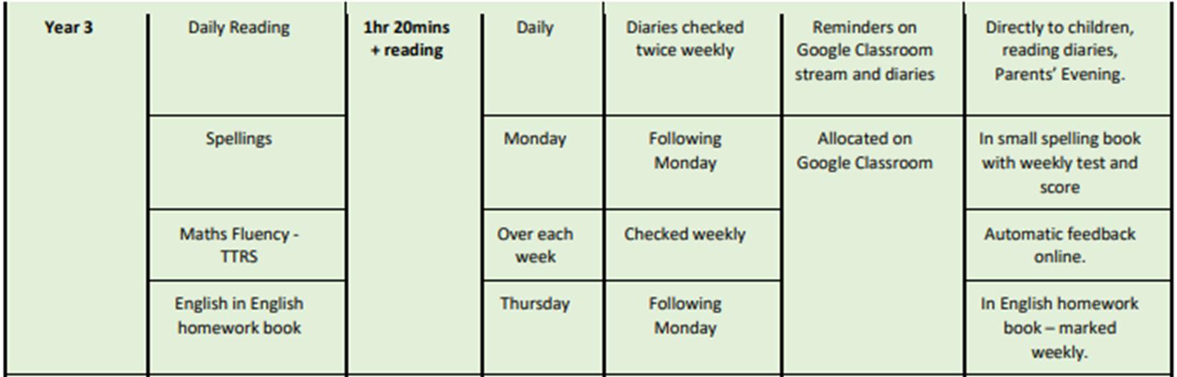
Home Learning
EYFS home learning will be shared and completed on Tapestry
Y1-6 home learning will be shared and completed on
Google Classrooms.

Slide 19
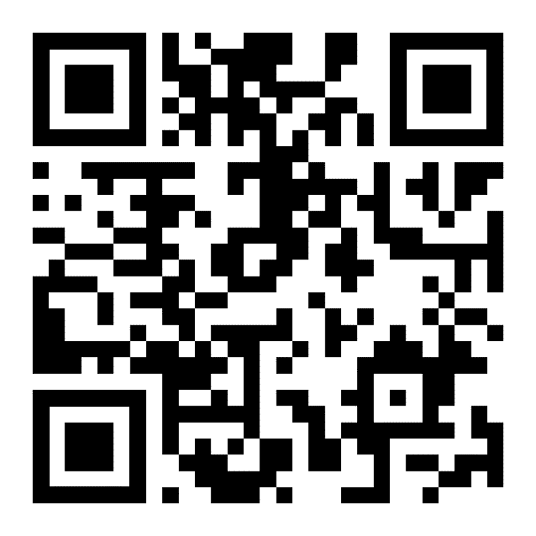
How you can help
Thank you for all that you already do to help and support our school!
Parent Volunteers
We are looking for parent volunteers to help with reading, displays and resources. If you are able to commit your time regularly (weekly or fortnightly) for the year, please contact Mrs Bastian (tbastian@sacredheart.merton.sch.uk) or complete the Google Form sent out to parents.
Curriculum Enrichment Fund
A voluntary contribution from parents of £10 per term for each pupil (via ParentPay) to fund learning opportunities we cannot afford to pay from the government funding we receive.
All pupils benefit from the fund regardless of whether parents have made the voluntary contribution or not, however, a larger allocation of the funding will go towards those year groups / classes that have contributed the most.
Please visit our website for more information: https://www.sacredheart.merton.sch.uk/how-you-can-help-funding-donations-volunteers/
Scan this QR code to get a link to the parent volunteer form

Slide 20
Thank you for attending our Meet the Teacher meeting.
We look forward to working with you this year.

